Slide 1
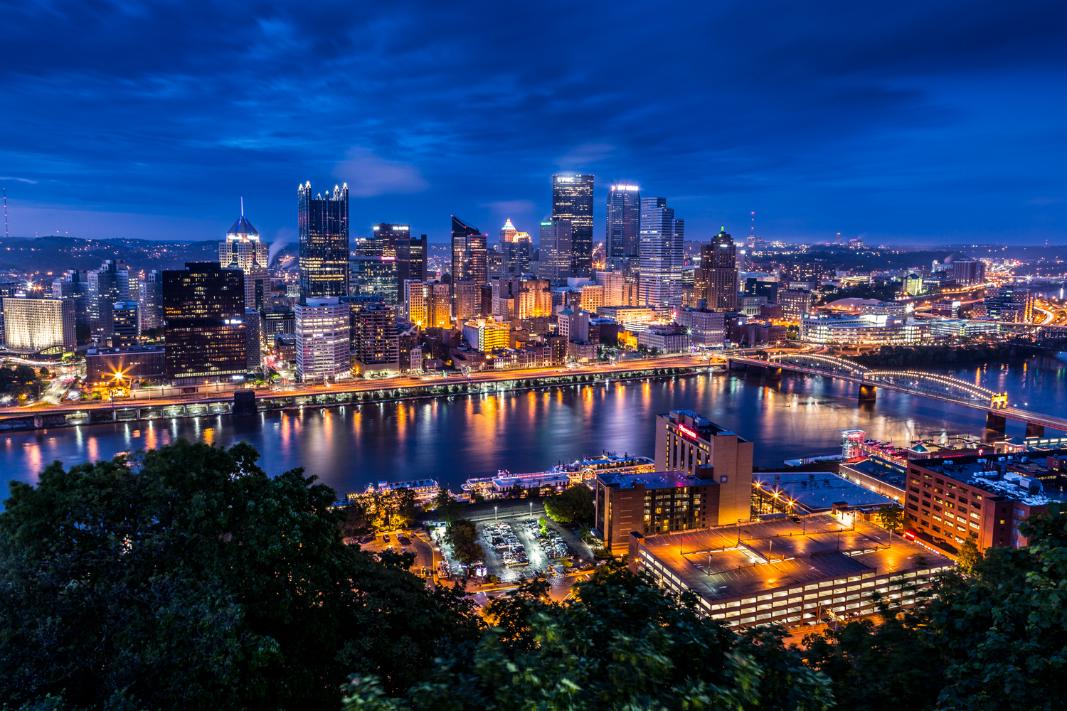
_{Battle of Neighborhoods} _{QUEENS NEW YORK}

Slide 2
Background
Being one of the world's most flourishing regions thanks to its bustling economic environment, New York is an ideal candidate for ambitious entrepreneurs. Data shows that among New Yorkers are some of the most wealthy businessmen of the world; this is reflected, however, by an increase in the cost of living, in the form of expensive rents and steep taxes. While this does not discourage new businesses from emerging, it makes choosing the right setting a difficult matter.

Slide 3
Problem
Possibly the biggest challenge for any New York City business is going to be the wide array of competition. With more than 8 million New Yorkers, the market tends to be over-saturated in almost every industry. Businesses now have to go farther than just offering a service and focus on well thought out marketing strategies to grow. With Queens having one of the most diverse places in the nation. Half of the neighborhood’s residents speak Spanish. Others speak Chinese, Urdu, Hindi, Russian, Portuguese, Greek or Korean. Altogether, the neighborhood is said to be the home of 167 languages. It will be a challenges on what business to start and offer these culture diverse in one of the five boroughs of New York City with it having the largest borough geographically.

Slide 4
Solving the Problem Using Data Science
We are going to take advantage of the Foursquare database to gain insight about the New York area, eventual competitors, and optimal location.

Slide 5
Data section
We will import the ZIP Code Definitions of New York City Neighborhoods which is available from:
https://www.health.ny.gov/statistics/cancer/registry/appendix/neighborhoods.htm
And append them to our dataset, in order to pinpoint the optimal location, scoping our way through a multitude of venues thanks to the Foursquare API.

Slide 6

Methodology
Collect Data
Explore and Understand Data
Data Preparation and Preprocessing
Modeling

Slide 7
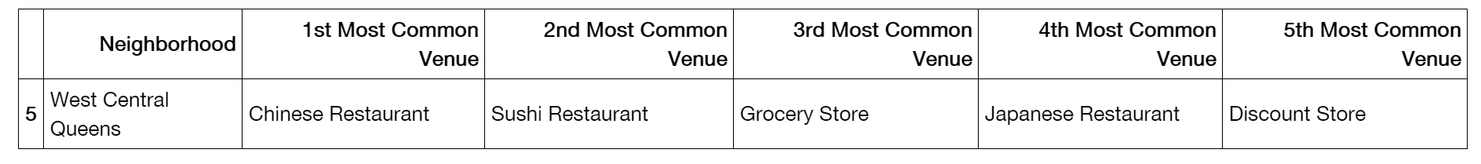
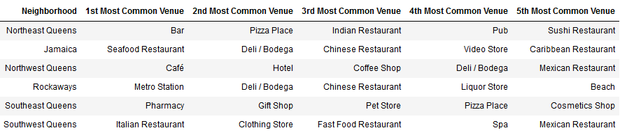
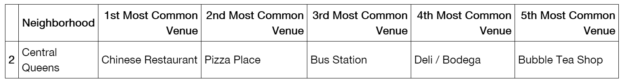
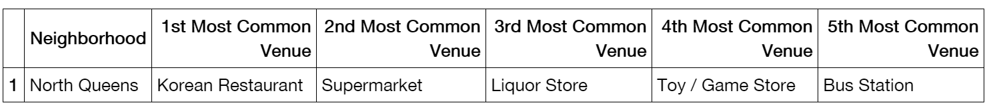
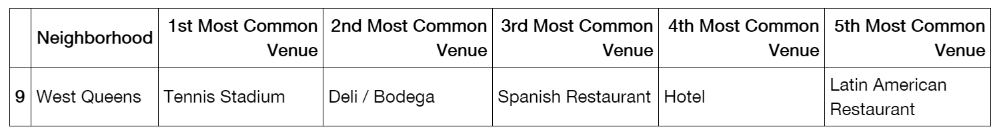
•
Cluster 1
•
Cluster Details
Cluster 2
•
Cluster 3
•
Cluster 4
•
Cluster 5

Slide 8
Results and Discussion
All clusters have 20 restaurants and food places on the area that caters to specific cuisines.
Cluster 1 has 1 neighborhood with 3 restaurants as common venues, 1 store, and a gym.
Cluster 2 has 6 neighborhoods with 13 distinct variety of restaurants but has different types of stores.
Cluster 3 has 1 neighborhood with 2 restaurants and a specialized bar.
Cluster 4 has 1 neighborhood with 1 restaurant, a supermarket, and a bus station.
Cluster 5 has 1 neighborhood with 2 restaurants as common venues, a hotel and a tennis stadium.The geographic location does give us a good overview of the metropolitan environment.
A good approach for a new businesses might be to start where there's a high concentration of restaurants, and cater to one of the specific cultures found in the borough. The neighbourhood from Cluster 2 appears to be the best candidate for our purpose
The KMeans method we applied gives a new entrepreneur a good starting point on what business model is more likely to develop successfully, based on the type of venues identified using Foursquare api. The cluster of venues identified within the neighborhood is predominantly restaurants and food shops, but there is no nearby Korean restaurant or bubble tea shop - two kind of venue that appear to be trending in other boroughs - both excellent choices for a new, trendy activity.

